Slide 1

A Blueprint for Green Human Capital Sustainability and Improved Performance
Belia Nel
ISPI EMEA Conference
North Macedonia
September 2019

Slide 2
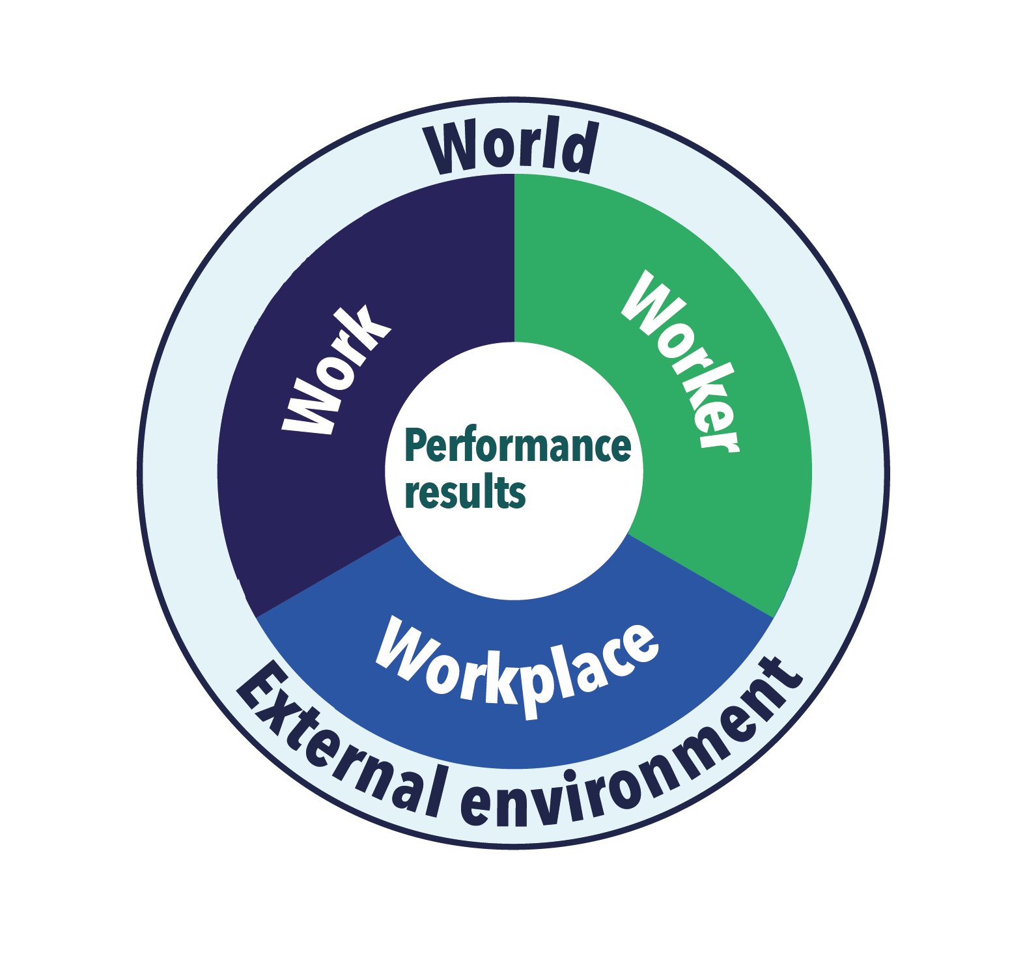
Systemic View

Slide 3
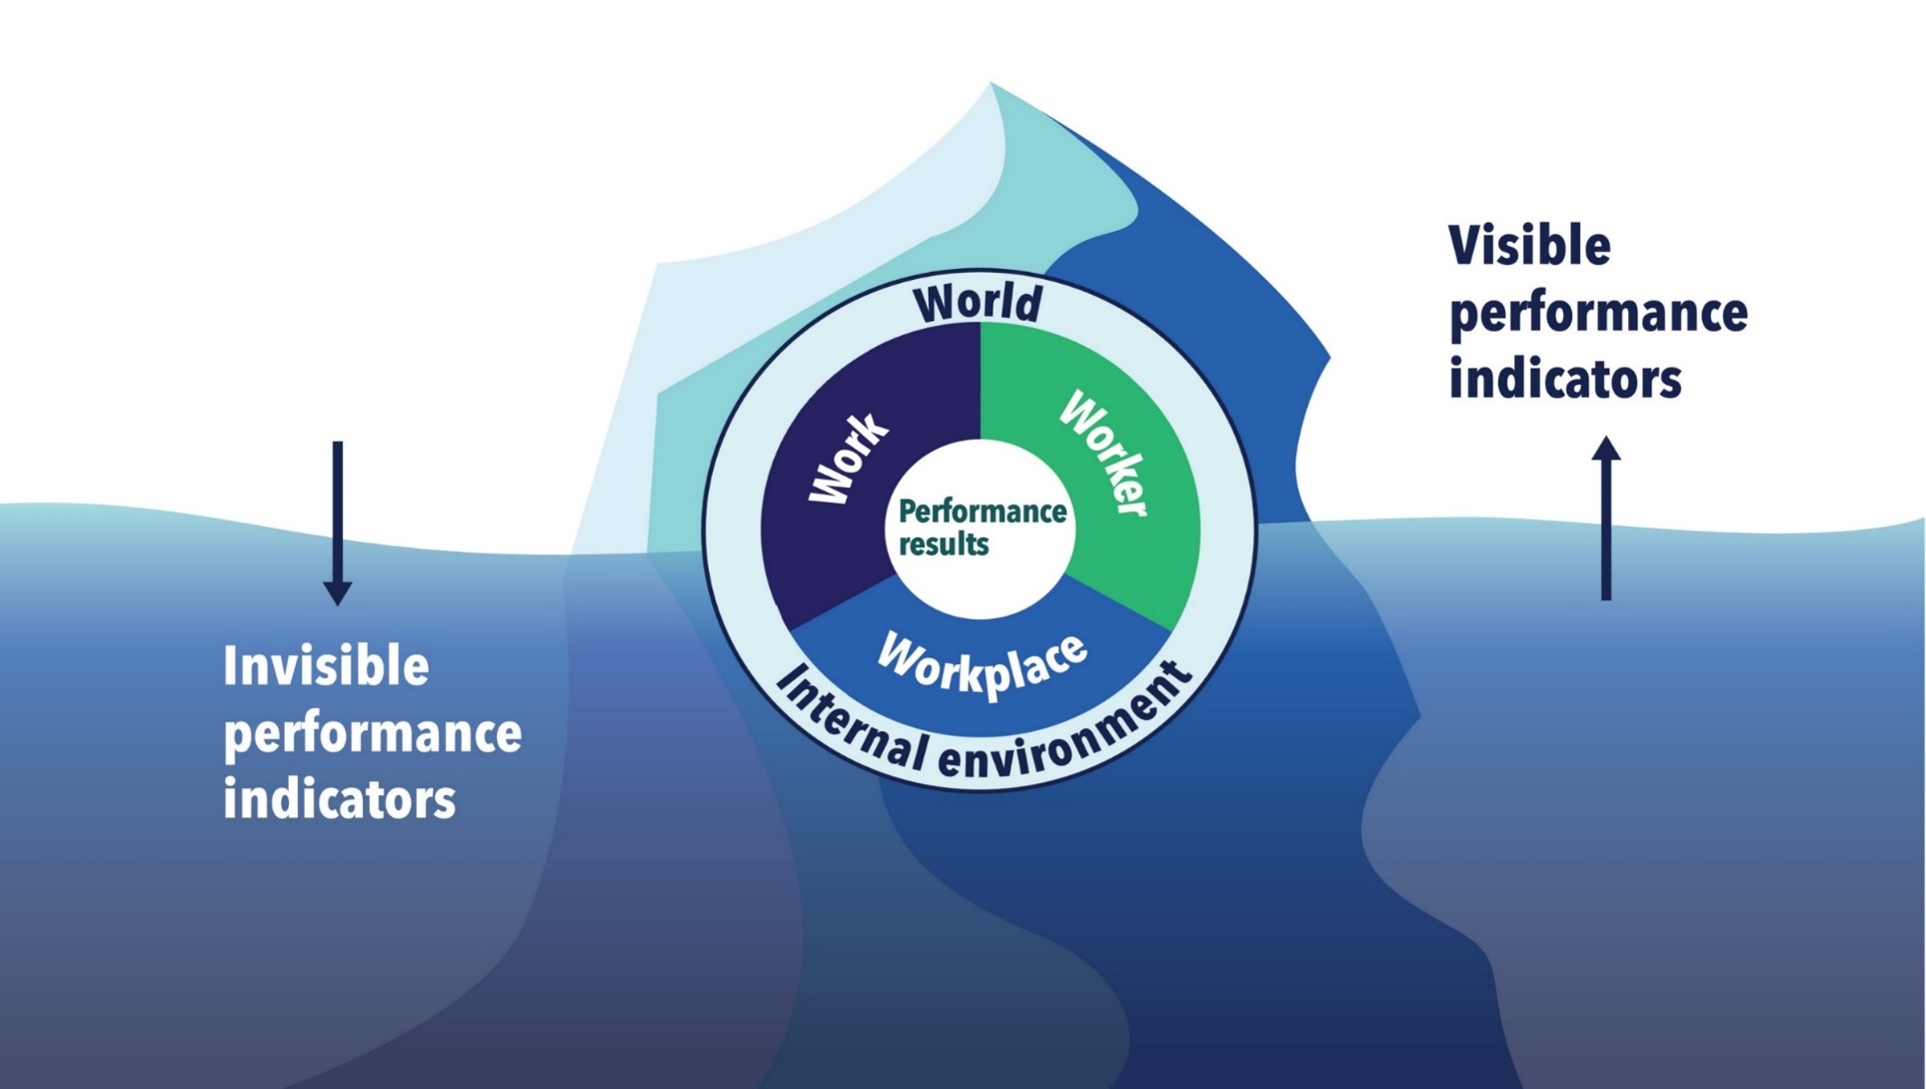
Performance Improvement Practice

Slide 4
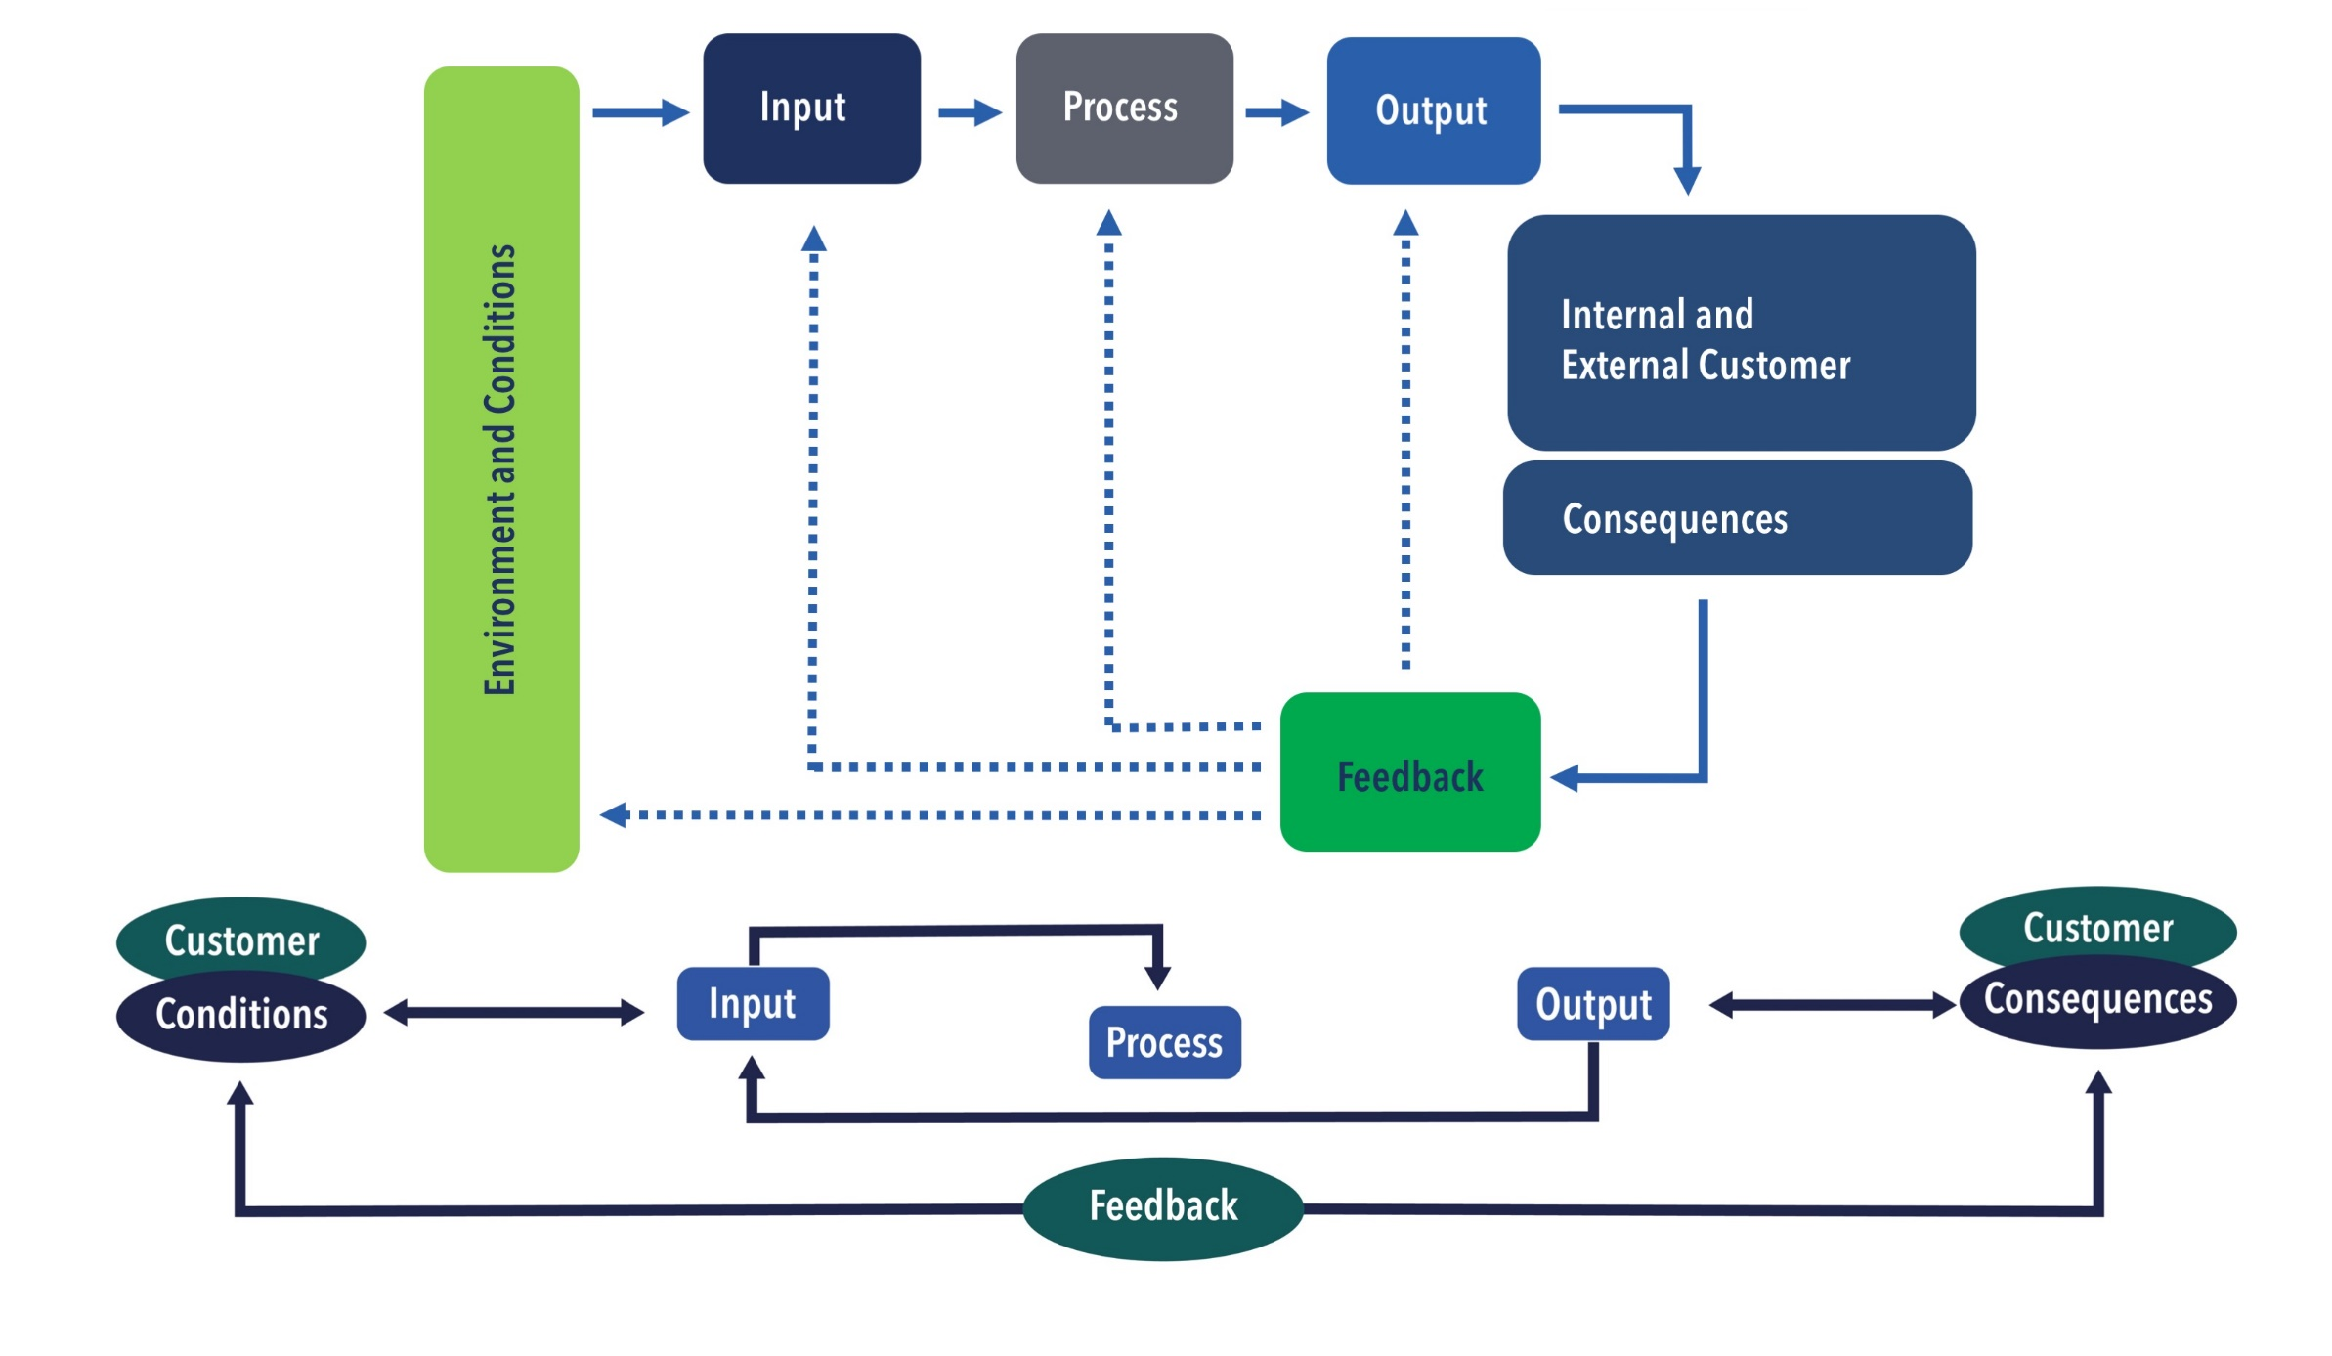
Performance Improvement Foundation

Slide 5
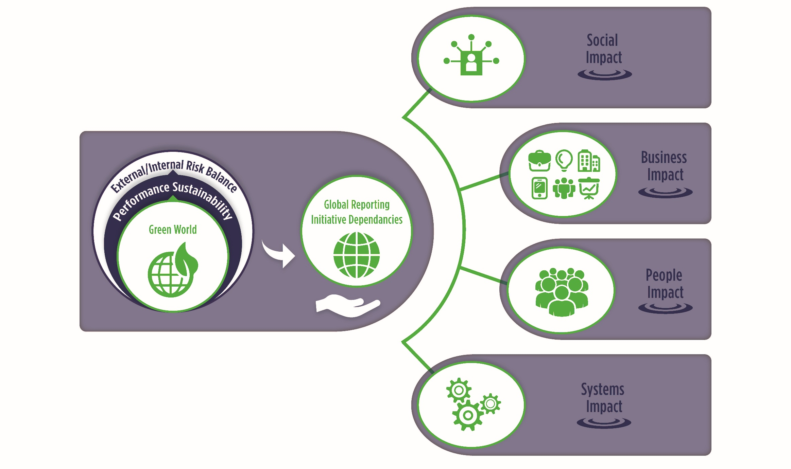
Performance Sustainability Approach

Slide 6
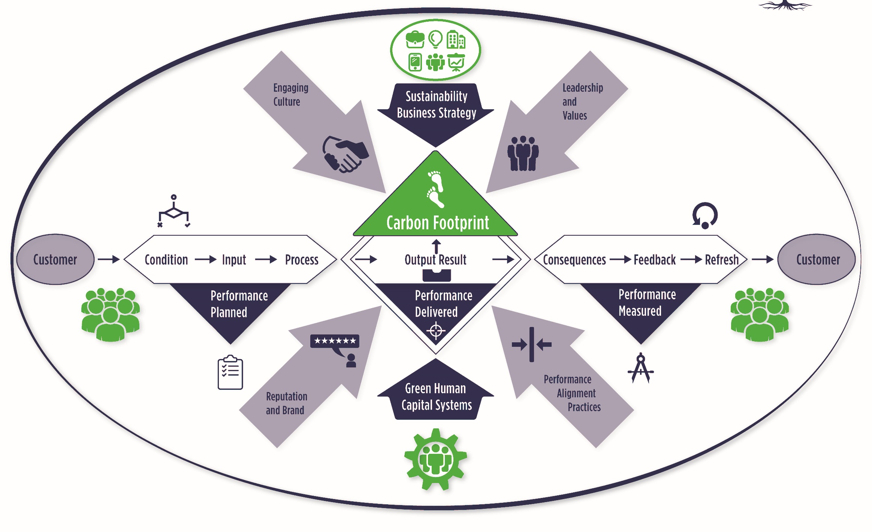
Green Human Capital Framework

Slide 7
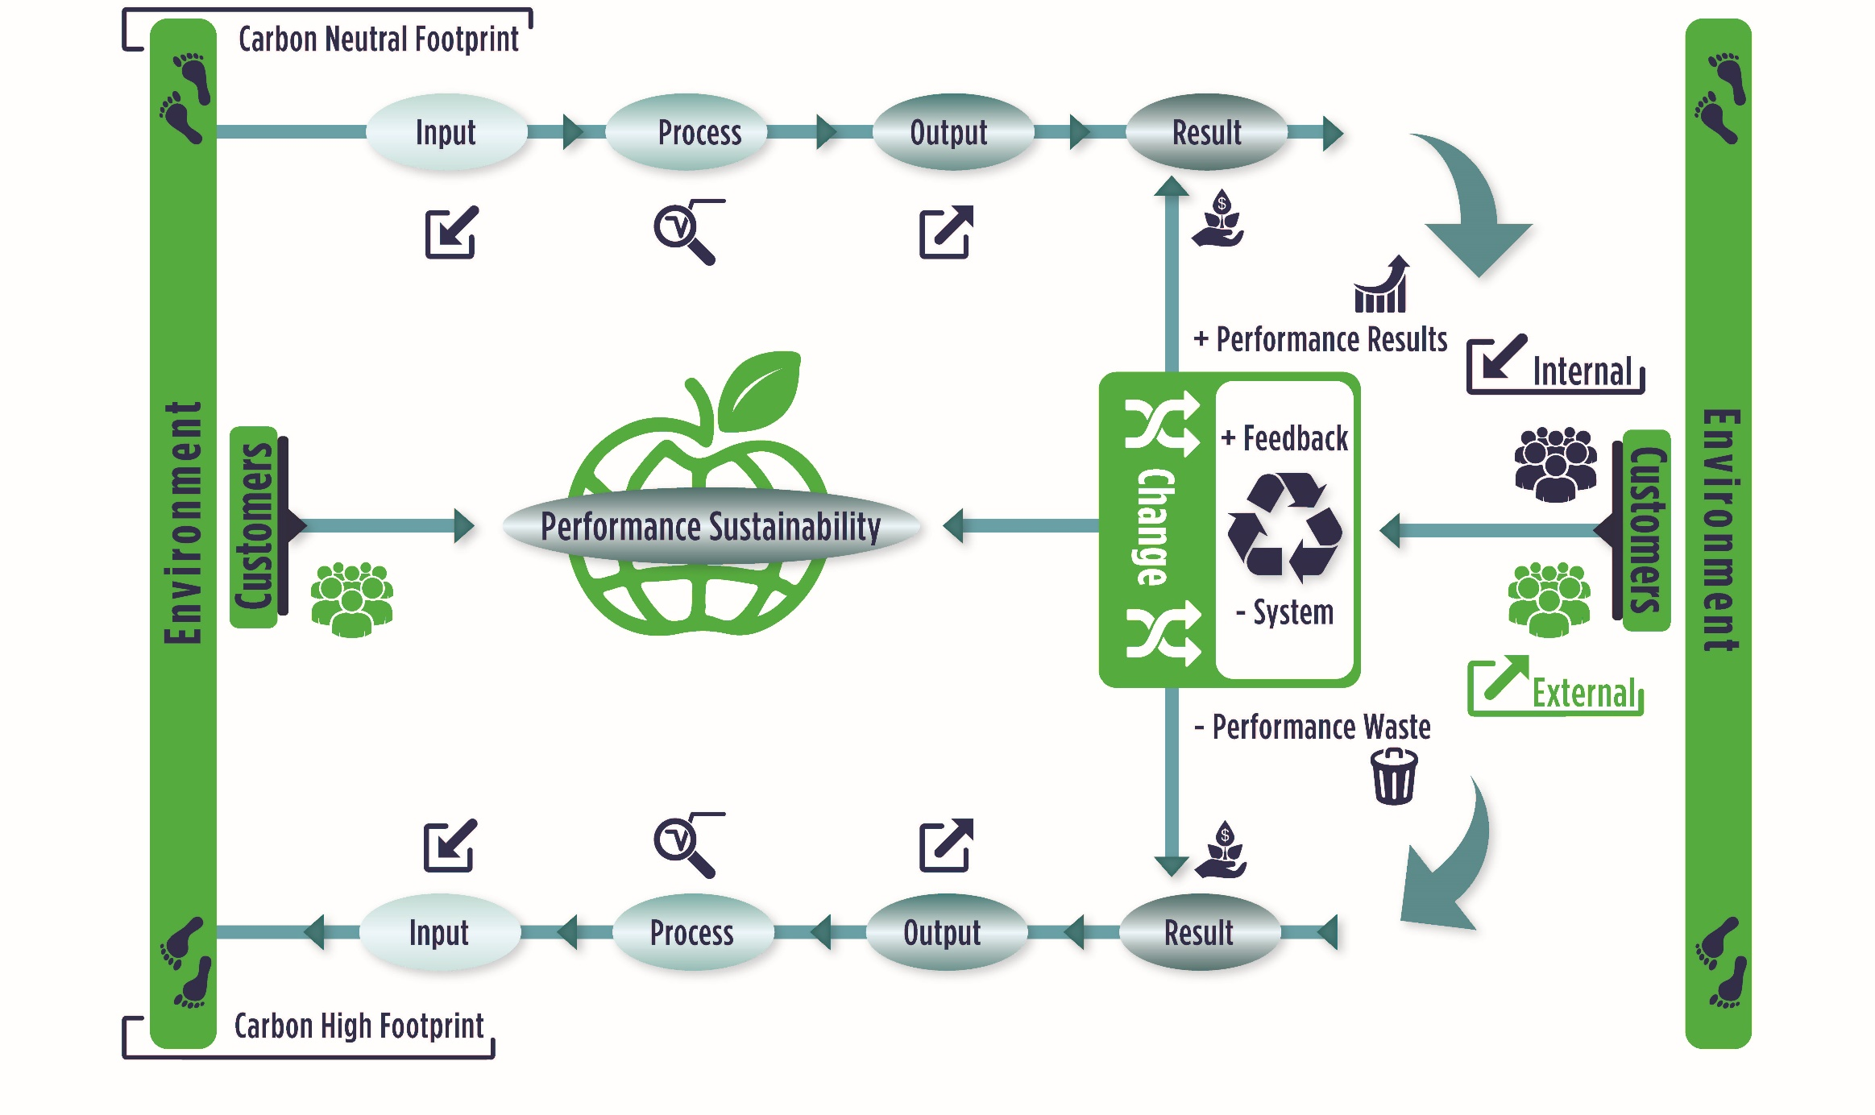
Positive/Negative Green Human Capital Recycling

Slide 8
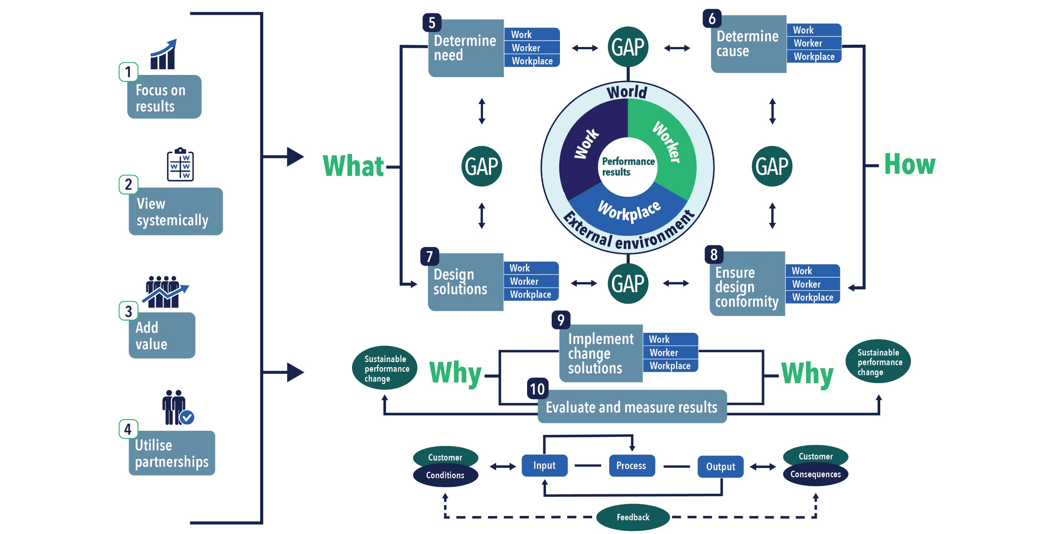
Methodology Process Steps

Slide 9
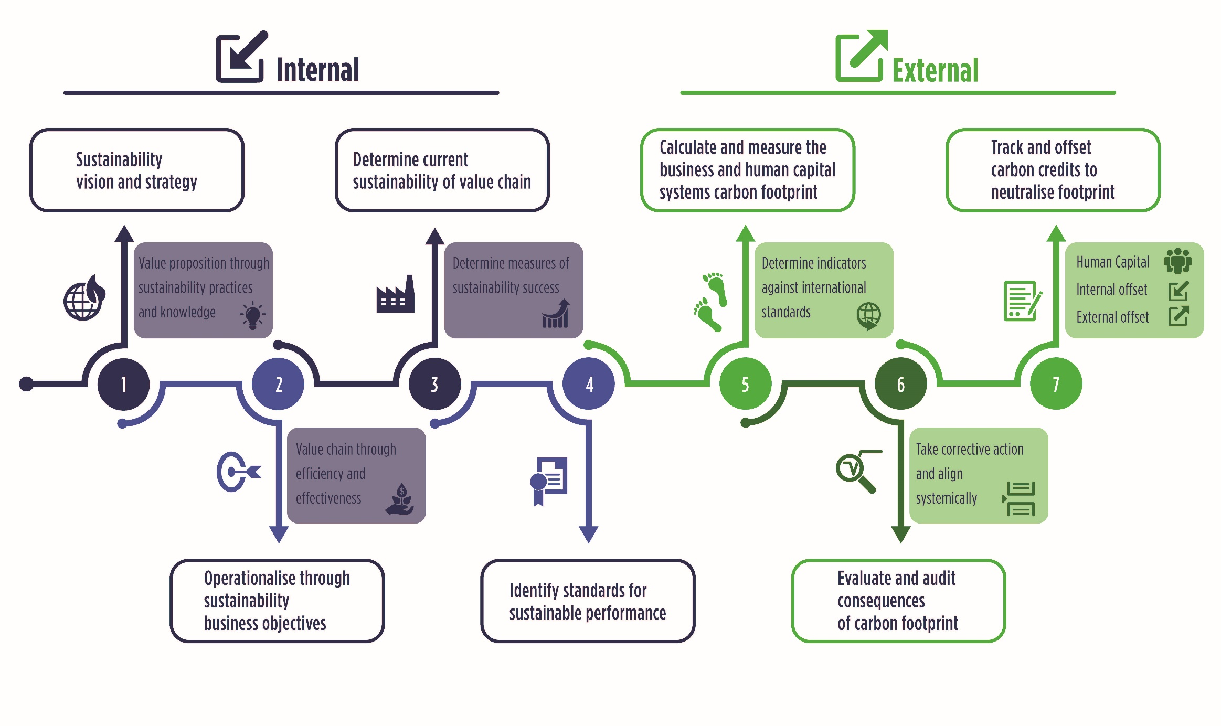
Action Steps for Sustainability

Slide 10
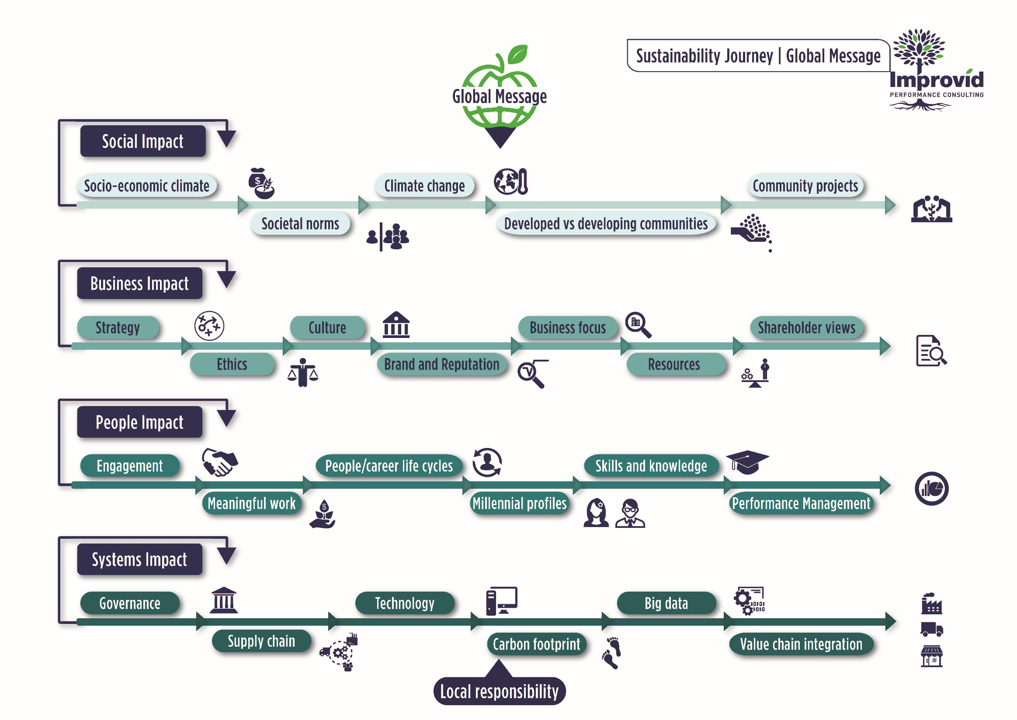
Sustainability Journey – Global Message

Slide 11
Sustainable Performance Integration

Slide 12
Articles
1. Will the real performance broker please stand up?
https://www.ispi.org/PerformanceXpress/PX/Articles/Editors__Pick/EDITOR_S_PICK_SEPTEMBER_2019.aspx
2. A Blueprint for Green Human Capital Sustainability and Improved Performance
https://improvidblog.com/2018/12/11/the-blueprint-for-green-performance-sustainability/

Slide 13

Thank you
Belia Nel
belia@improved.co.za
www.improvidblog.com
www.improved.co.za

